Slide 1

VIRTUAL MOUSE
DELHI TECHNOLOGICAL UNIVERSITY
(formerly DELHI COLLEGE OF ENGINEERING)
Presented By:
RAUNAK PODDAR(2K21/ISY/20)
KARAN YADAV (2K21/ISY/11)

Slide 2
Introduction
We have created a mouse controller using Python and OpenCV with real time camera that detects hand landmarks , track gesture patterns instead of physical mouse.
We will first detect the hand landmarks and then track and click based on these points.
We will find the tip of the index finger and middle finger and checks which fingers are up.
If index finger is up then it is in moving mode.
If both index and middle fingers are up means clicking mode.
We will also apply smoothing techniques to make it more usable.

Slide 3
Libraries Used
OpenCV:- OpenCV is used for image processing and drawing.
Autopy:- For controlling the mouse movements and for performing clicks. Autopy have several function which will control the mouse movements.
Numpy :- Numpy is used to perform certain mathematical calculations and for working with arrays.
Time:- Used to calculate FPS (Frames per Second).

Slide 4
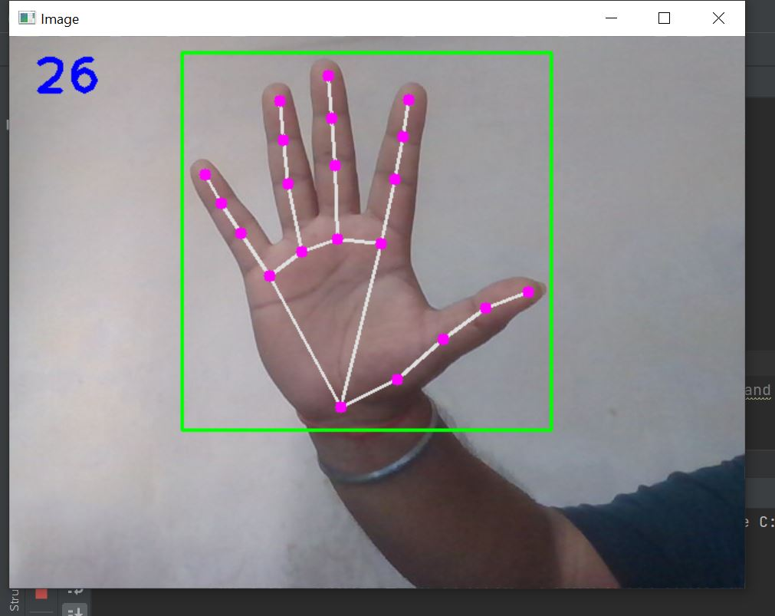
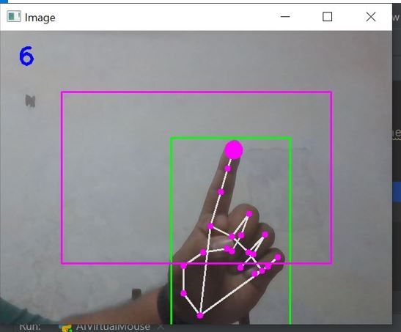
Hand Detection and Moving Mode
We will use WebCam to detect the hand. Here we will detect only one hand.
We will check for the finger tips of the detected hand.
From Thumb to pinky finger we have the finger tip as [4,8,12,16,20] to perform mouse movement.
We will mainly find the finger tips of index and middle fingers.
If only index finger tip up then we have moving mode and we can able to move our mouse freely.
Moving of mouse is done by autopy library.

Slide 5
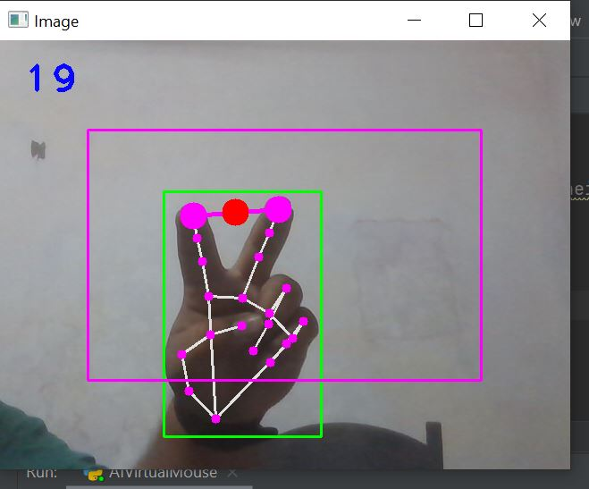
Clicking Mode
We will check if the index finger and middle finger together tip up then our virtual mouse is in clicking mode.
We will then find out the distance between the finger.
To perform clicking we need to move index finger and middle finger closer i.e., to the red circle.
When the distance between them is getting shorter then it will perform click operation.
Clicking operation is done by autopy library.

